Slide 1

SAMPLING
"Some people hate the very name of statistics but I find them full
of beauty and interest.”
(FRANCIS GALTON)
PREPARED BY : NOR SAMSUHADA AHMAD

Slide 2
LEARNING OUTCOMES
By the end of the topic, students should be able to :
To identify types of various sampling techniques
To apply sampling techniques in solving problems

Slide 3





Sources of Data
Data
Measure on the variables of interest obtained from a sample
Primary data
Secondary data

Slide 4
Primary Data
Information obtained first hand by researcher on the variable of interest for the specific purpose of the study
E.g. :a researcher interview the respondents and record their responses
Advantages: more accurate and consistent
Disadvantages: more time, manpower, and higher cost

Slide 5
Secondary Data
Information gathered from sources that already exist
E.g. :data from Bank Negara, Department of Statistics, journal
Advantages: easily accessible, inexpensive
Disadvantages: may lack accuracy, may be biased

Slide 6
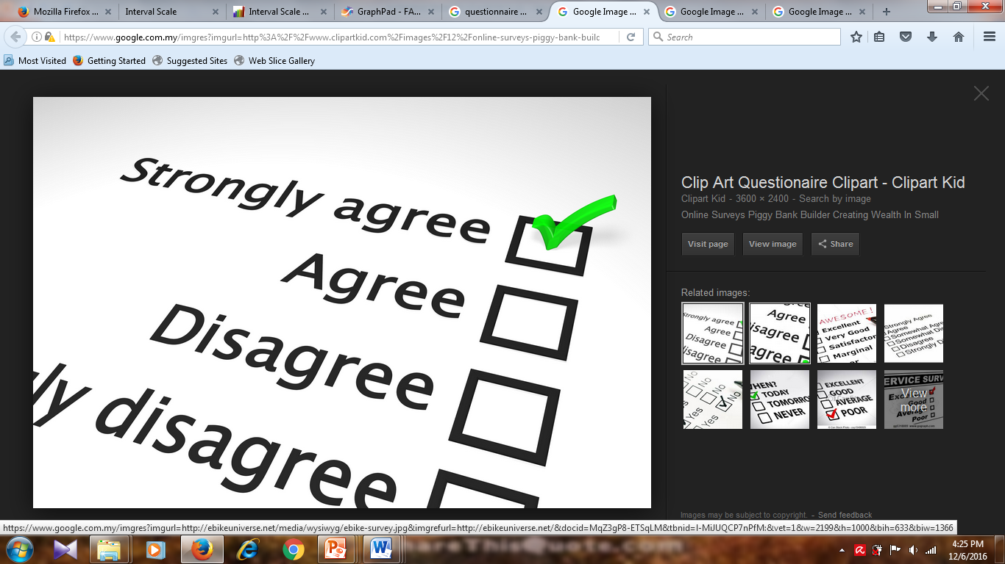
Designing a Questionnaire
Definition of Questionnaire:
A written instrument that contains a series of questions or items that attempt to collect information on a particular subject.

Slide 7
Steps When Designing A Questionnaire
HINTS IN DESIGNING A QUESTIONNAIRE
specify the information
avoid sensitive questions
avoid too many calculation
question ordering is important
keep the length of questionnaire short
use simple language
avoid leading questions
E.g. you never come home that night, right?

Slide 8
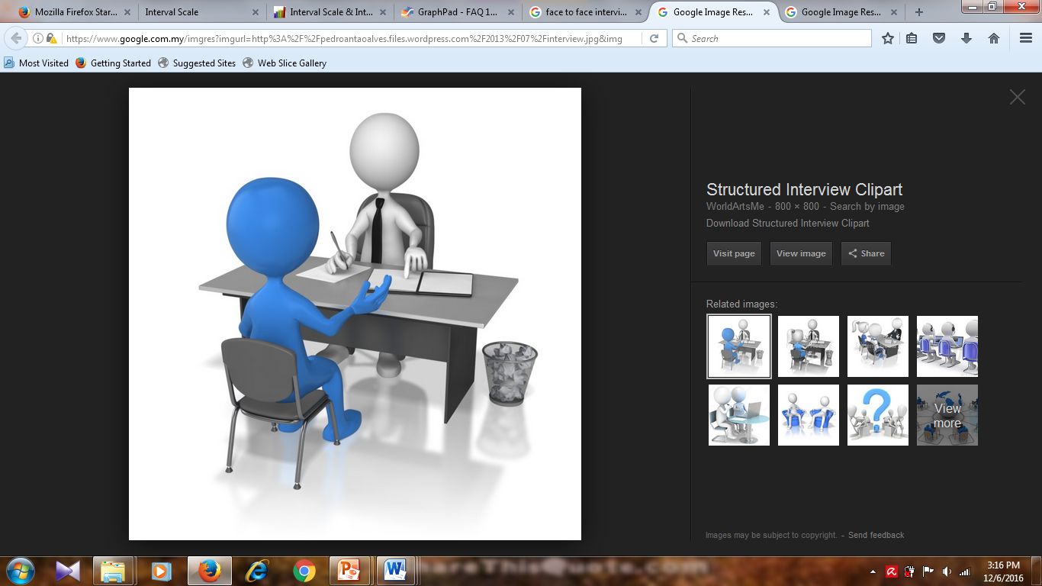
Method of Collecting Data
DIRECT INTERVIEW/ PERSONAL IV/FACE TO FACE IV
Trained interviewer will get the information from the respondents depending on the objective of the survey and based on questionnaires.
Advantages:
High response rate
Can clarify any terms that aren’t understood by the respondent and can note specific reactions and the environment surrounding the respondent.
Disadvantages :
Time constraint
High cost (pay interviewers salary, travelling,etc)

Slide 9
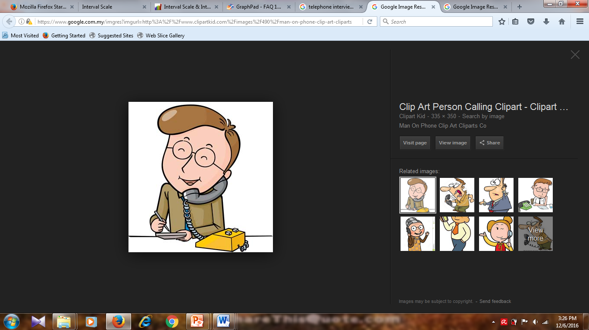
Method of Collecting Data (cont.)
TELEPHONE INTERVIEW
It is conducted by telephone services line and respondents are asked to respond to the questionnaire.
Advantages:
Less time
Less expensive
Disadvantages :
Only short questions can be asked.
Need to find the correct time to interview the respondents.

Slide 10
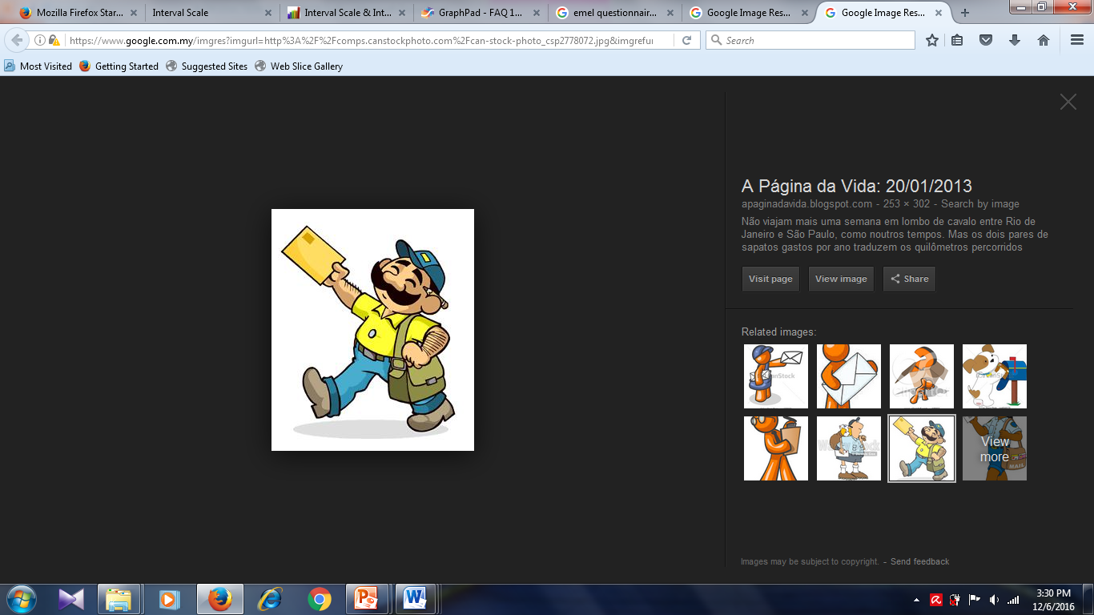
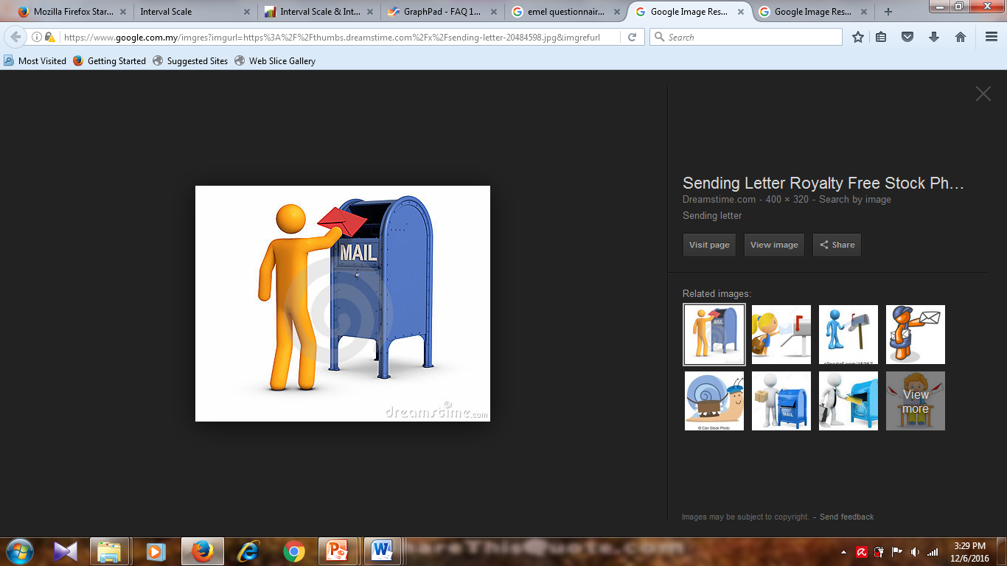
Method of Collecting Data (cont.)
MAILED QUESTIONNAIRE
Questionnaires are mailed to the respondent included from the sample.
Does not require interviewers.
Advantages:
Lower cost.
Convenience since wider region can be covered.
Disadvantages :
Lowest response rate
No one can assist the respondents in answering the questionnaire.

Slide 11
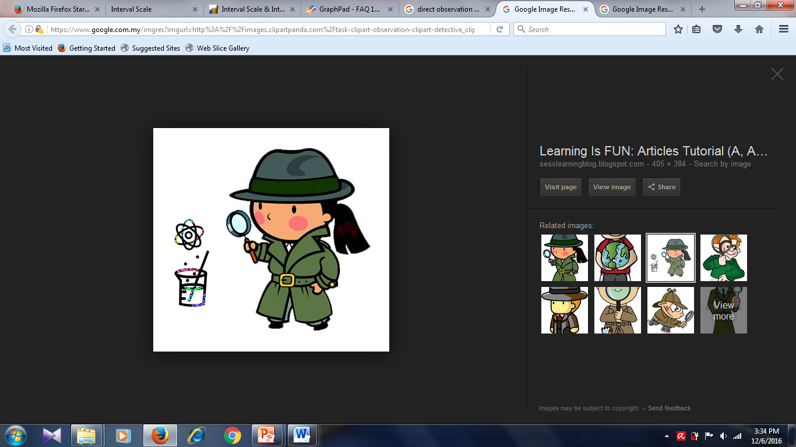
Method of Collecting Data (cont.)
DIRECT OBSERVATION
Used by social scientists in learning the habits and customs of communities.
Example : data are collected by taking bulbs from the production line and observing the number of hours they last.
Advantages:
It records what actually happened rather than what people say would happen.
Disadvantages :
The observer will not get an accurate data if the respondents know that they are being observed.

Slide 12
Sampling
Definition :
Process of selecting a sample from a population
Advantages:
Reduce the costs.
Produce adequate info in a shorter period
Provide almost accurate info as resulting from census

Slide 13
Sampling (cont.)
ERROR
SAMPLING ERROR
NON-SAMPLING ERROR
Occurs because a sample cannot give complete info on a population
Can reduce and eliminate error:
Carefully designing the survey design
Choose the correct sampling technique
Occurs from the survey due to:
Non-response from respondent
Faulty measuring device
Respondents giving false information
Error in writing and analyzing the data

Slide 14
Sampling (cont.)
PROBABILITY SAMPLING
Any method of sampling that utilizes some form of random selection.
In order to have a random selection method, you must set up some process or procedure that assures that the different units in your population have equal probabilities of being chosen.
NON-PROBABILITY SAMPLING
Does not involve random selection.
Used when sampling frames are difficult to obtain.
Is considerably less expensive than doing probability sampling, but the results are of limited value.

Slide 15
Sampling Technique
SIMPLE RANDOM SAMPLING
STRATIFIED SAMPLING
CLUSTER SAMPLING
MULTISTAGE SAMPLING
SYSTEMATIC SAMPLING
JUDGEMENTAL SAMPLING
QUOTA SAMPLING
CONVENIENT SAMPLING
PROBABILITY SAMPLING
NONPROBABILITY SAMPLING

Slide 16
Sampling Technique (cont.)
PROBABILITY SAMPLING
SIMPLE RANDOM SAMPLING (SRS)
Assures every element in the population has an equal chance of being included in the sample.
Used when the items are from a group of the same characteristics.
How to select the sample?
Small pop (n <300)
Use “lottery method” where each item will be given a number on a piece of paper and place in a box. Number will be selected one at a time.
Large pop (n ≥ 300)
Use random number table.
Advantages :
All elements have equal chance of being selected.
Disadvantages :
Tedious for very large pop.
Respondents may be widely scattered, hence it will produce higher cost.

Slide 17
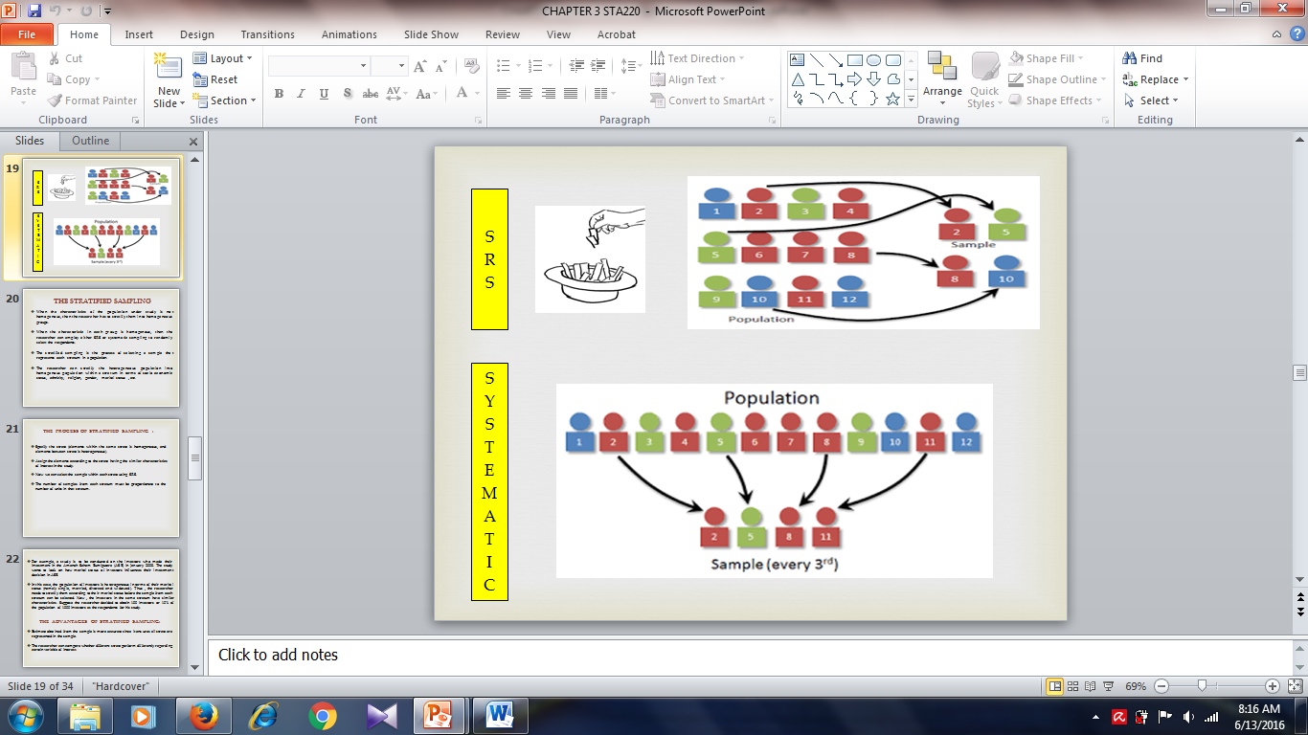
Example

Slide 18
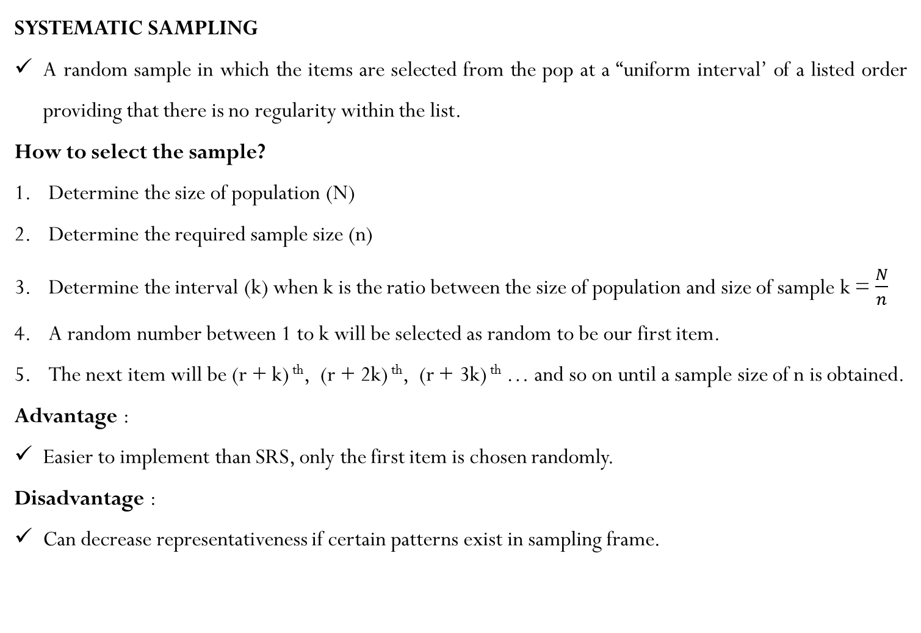
Sampling Technique (cont.)
PROBABILITY SAMPLING
SYSTEMATIC SAMPLING
A random sample in which the items are selected from the pop at a “uniform interval’ of a listed order providing that there is no regularity within the list.
How to select the sample?
Determine the size of population (N)
Determine the required sample size (n)
Determine the interval (k) when k is the ratio between the size of population and size of sample k = $\frac{N}{n}$
A random number between 1 to k will be selected as random to be our first item.
The next item will be (r + k) ^{th}, (r + 2k) ^{th}, (r + 3k) ^{th} … and so on until a sample size of n is obtained.
Advantage :
Easier to implement than SRS, only the first item is chosen randomly.
Disadvantage :
Can decrease representativeness if certain patterns exist in sampling frame.

Slide 19
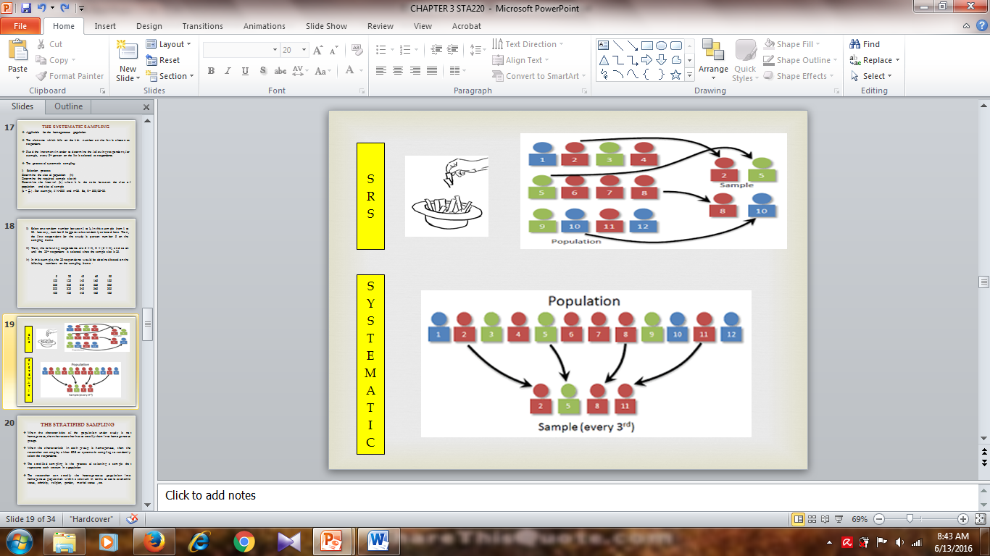
Example

Slide 20
Sampling Technique (cont.)
PROBABILITY SAMPLING
STRATIFIED SAMPLING
Used when the population is divided into suitable subpopulations where between groups are heterogeneous and within groups are homogeneous.
All the groups will be selected and item from each group will be selected randomly using SRS or systematic sampling.
Example: a lecturer is interested to conduct a research on reading habits among semester two students at Cerdas College. Select a sample of 60 students from a population of 200 students.
Advantage :
The sample will be more representative of the populations.
Disadvantage :
Difficult in selecting the samples if the sampling frame is not available.

Slide 21
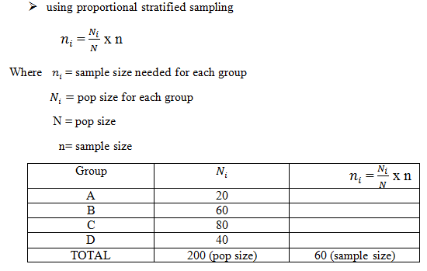
Sampling Technique (cont.)
PROBABILITY SAMPLING

Slide 22
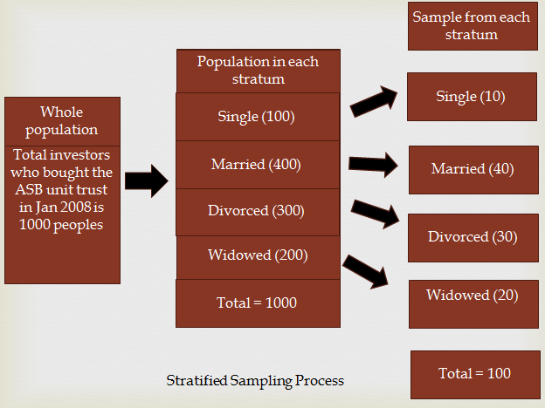
Example

Slide 23
Sampling Technique
PROBABILITY SAMPLING
CLUSTER SAMPLING
Used if the population is divided into sub population where between groups are homogeneous and within groups are heterogeneous.
The groups will be selected at random
All items in each group will be chosen
Advantage :
Reduce time, cost and workforce since only a few clusters formed are selected as sample.
Disadvantage :
Difficult to compute and interpret the result.

Slide 24
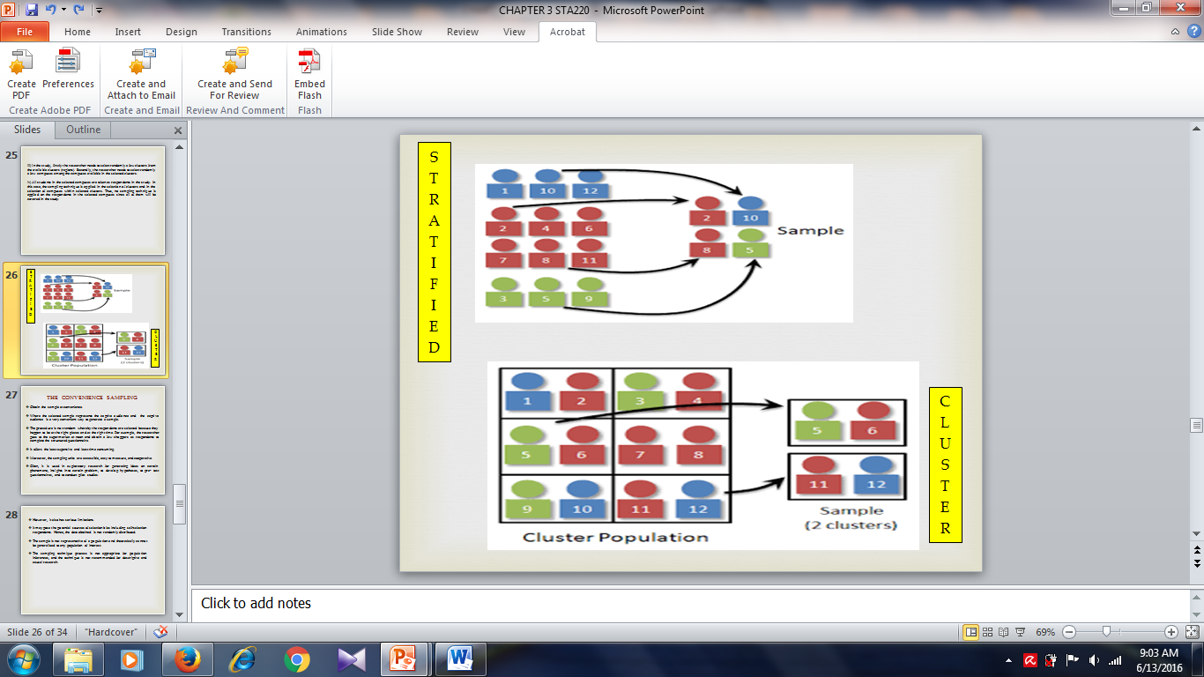
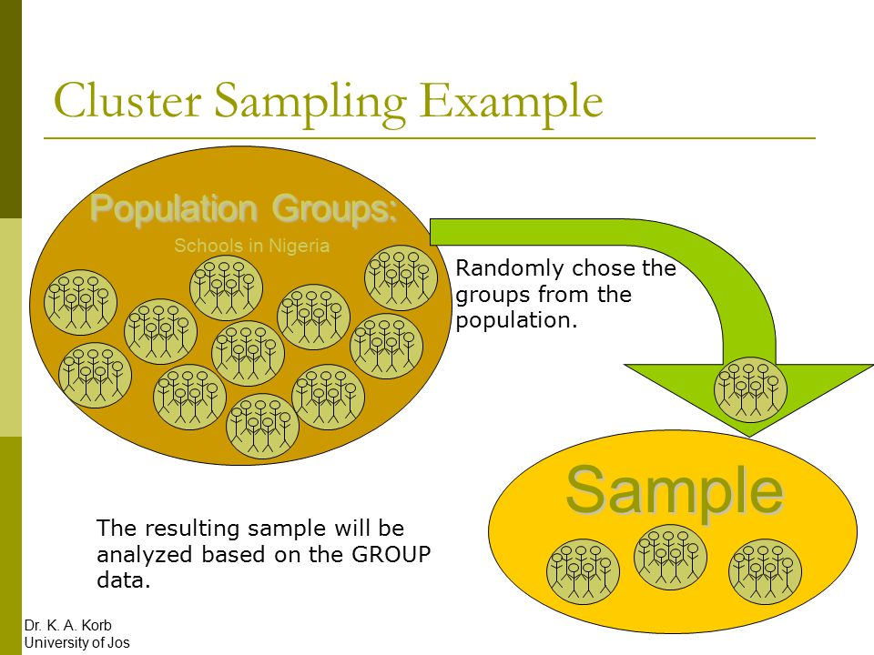
Example

Slide 25
Sampling Technique
PROBABILITY SAMPLING
MULTISTAGE SAMPLING
Used to cut down the survey area and reduce the survey costs from very large population.
Example : We need to get random sample of 2000 residents from the Malaysia population. Since we have 14 states districts villages.
Advantage :
Reduce time, cost and workforce for very large population
Disadvantage :
No assurance of representation for a very large population.

Slide 26
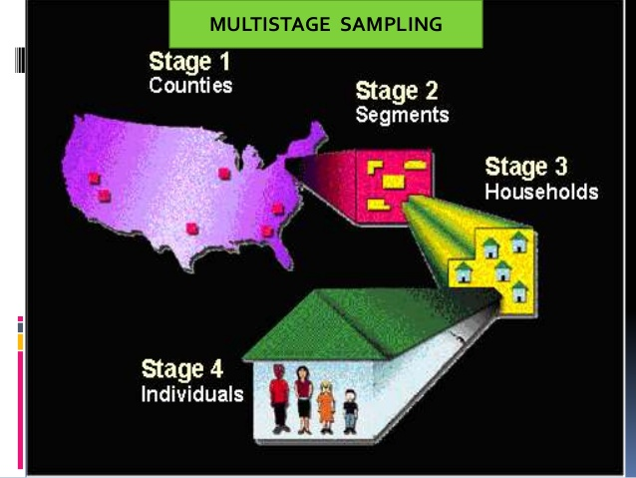
Example

Slide 27
Sampling Technique
NONPROBABILITY SAMPLING
CONVENIENT SAMPLING
Used to obtain those units/people most conveniently available.
It is most convenient sample or most economical sample.
The selection of elements/sampling units is left primarily to the interviewers.
Respondents are selected because they happen to be in the right place at the right time.
Example: an interviewer may look for respondents at the shopping complex, an airport or a stadium to interview.
Advantage:
Choose the sample that is most convenient to you
Disadvantage:
May suffer from biases since sampling frame is not known and sample is chosen at random.

Slide 28
Sampling Technique (cont.)
NONPROBABILITY SAMPLING
QUOTA SAMPLING
Samples are selected on the basis of specific guidelines about which items and /or how many should be drawn.
Quota is set and interviewer is allowed to select sample according to quota.
Has the flexibility to choose whoever he wants by specification (could be character, the clothes worn, the hairstyle, the age group).
Example: an account officer is interested in knowing the types of people who invested at the Kuala Lumpur Stock Exchange ( KLSE) and the kinds of stock they invested in. He selected respondents by interviewing twenty persons per day at a brokerage firm nearby for ten days. The respondents were from many races where Malay, Chinese, and others are represented by 45%, 50% and 5% respectively. The interviews were done between 10 am till 4 pm.
This is a quota sampling because those selected as samples are only those who are at the brokerage firm between 10 am till 4 pm. Those who are not in the brokerage firm between these hours will not be selected as samples.

Slide 29
Sampling Technique (cont.)
NONPROBABILITY SAMPLING
QUOTA SAMPLING
Advantage:
Samples can be controlled for certain characteristics and this method can be easily implemented.
Disadvantage:
Risk of interviewer bias is very high; interviewers can choose the samples based on their interest.

Slide 30
Sampling Technique (cont.)
NONPROBABILITY SAMPLING
JUDGEMENTAL/PURPOSIVE SAMPLING
The researcher’s judgment is used to decide which population items will be included in the sample.
The researcher selects respondents whom he feels possessed certain characteristics that represent the population of interest based on his experience.
Example: the directors of ABC Company has decided to sample opinions regarding economic forecast next year. The Company’s President chooses those persons to be interviewed by telephone.
This is judgmental sampling because the specific individuals to be called aren’t selected randomly since the President’s judgment is used in the selection process.
Advantage:
Good judgment will give a good result.
Disadvantage:
The sampler must use good judgment in choosing items to be sampled.

Slide 31


Slide 32


